Slide 1
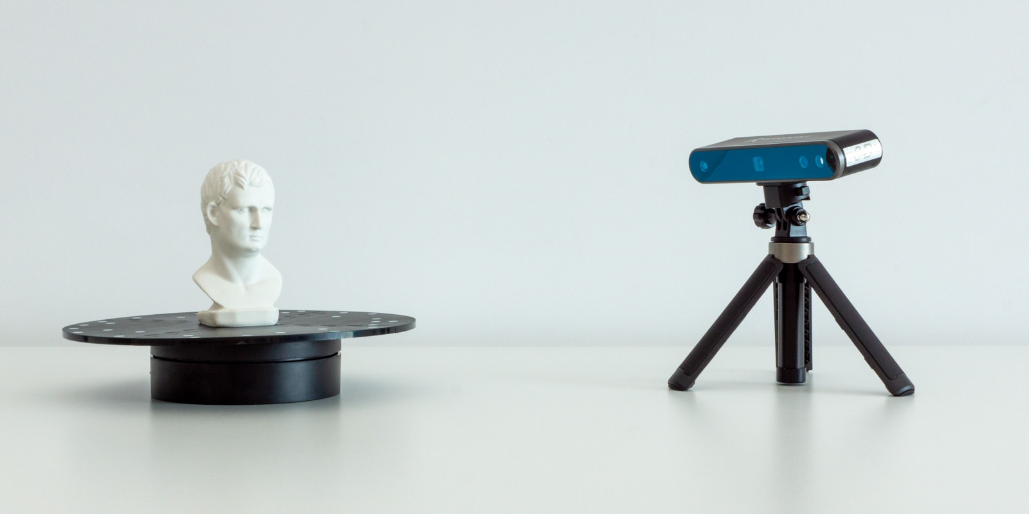
3D OBJECT SCAN USING 4 DEGREE OF FREEDOM ROBOTIC MANIPULATOR AND SENSOR
DONE BY : BALAJI NAMMALVAR

Slide 2
AIM:-
TO DESIGN A 4 DOF ROBOT MANIPULATOR AND INTEGRATE A SENSOR FOR 3D OBJECT SCANNING
OBJECTIVES:-
TO DESIGN A 4 DOF RRRP ROBOTIC MANIPULATOR.
INTEGRATE A SENSOR CAPABLE OF SCANNING OBJECTS.
TO FETCH THE 3D POINT CLOUD DATA BASED ON SENSING OF SENSOR.
GENERATE A COMPLETE MESH OUT OF THE 3D POINT CLOUD DATA FETCHED
USING THE CREATED MESH FOR REAL WORLD APPLICATIONS

Slide 3
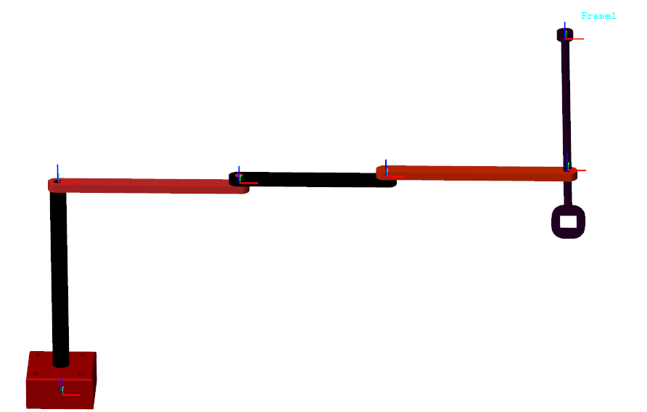
4 DOF ROBOTIC MANIPULATOR RRRP

Slide 4

OCTAGON

Slide 5
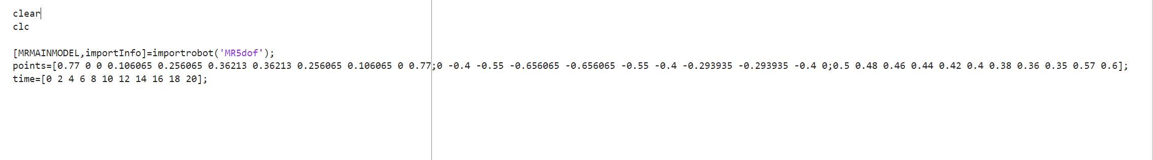
WAYPOINTS FOR OCTAGONAL PATH

Slide 6
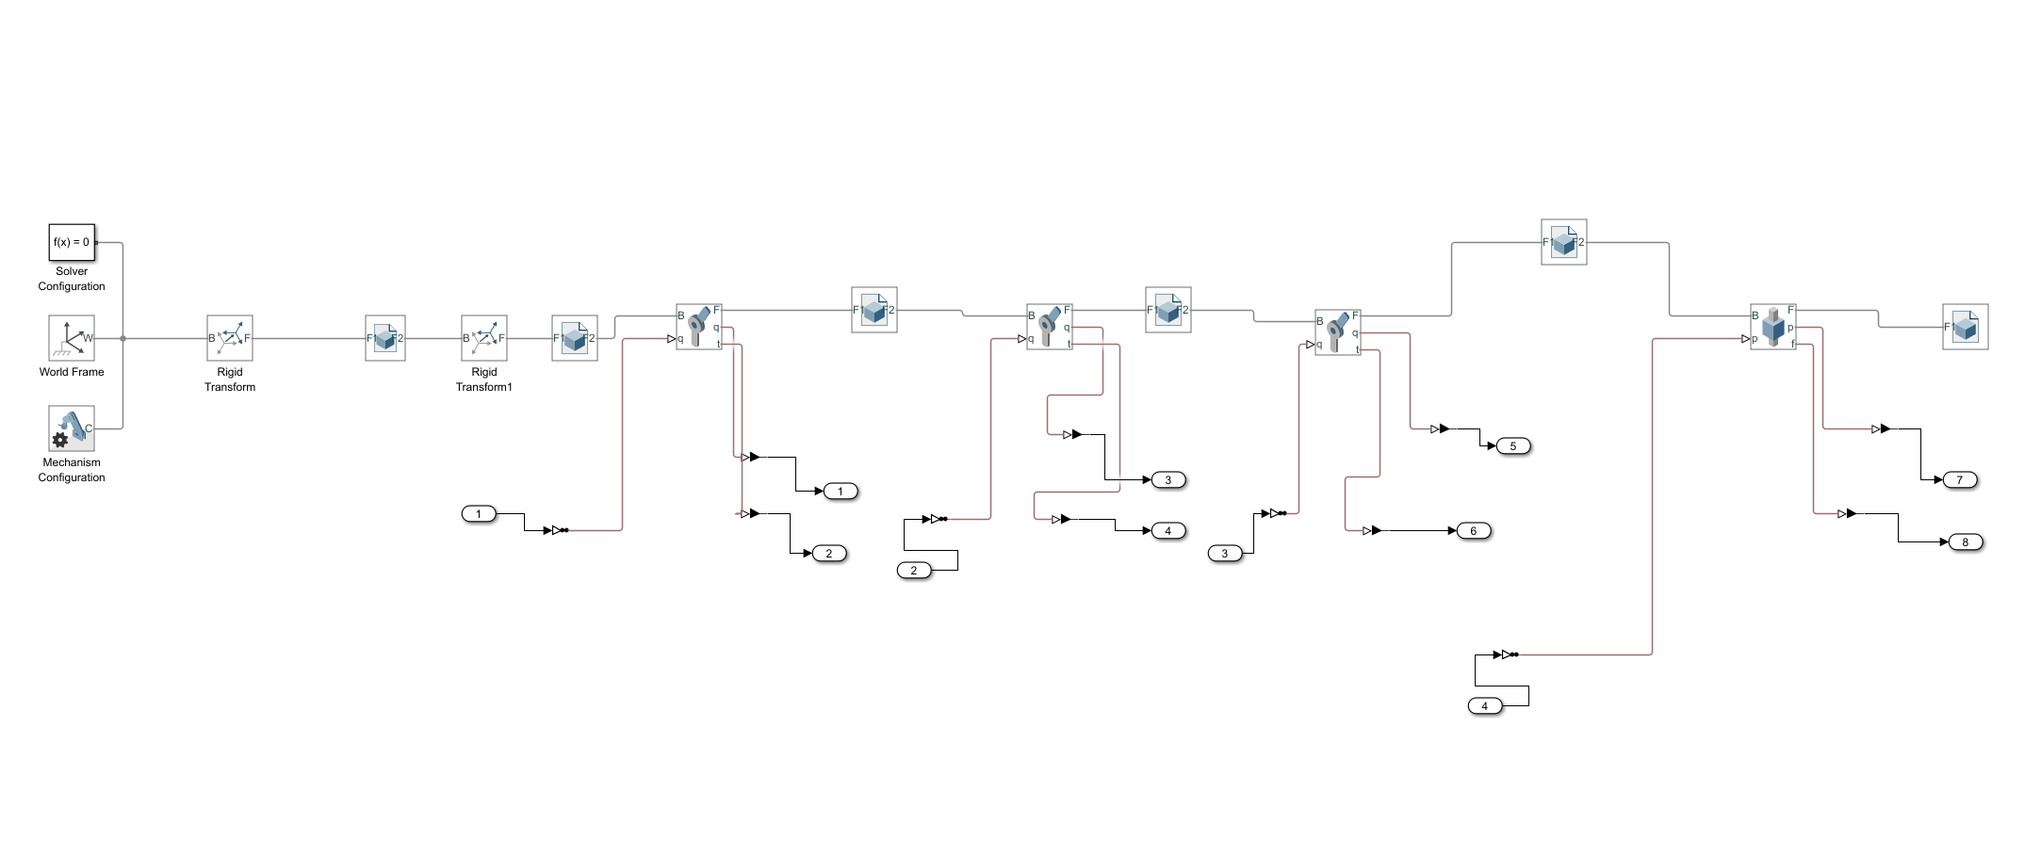
RIGID BODY TREE

Slide 7
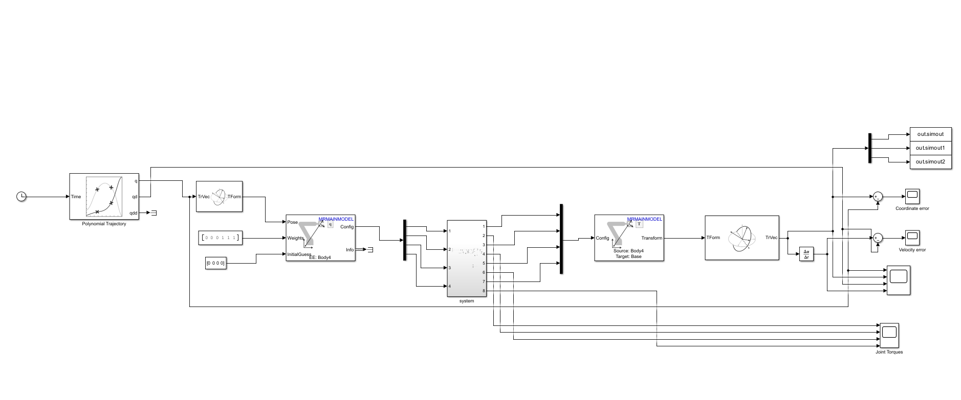

Slide 8
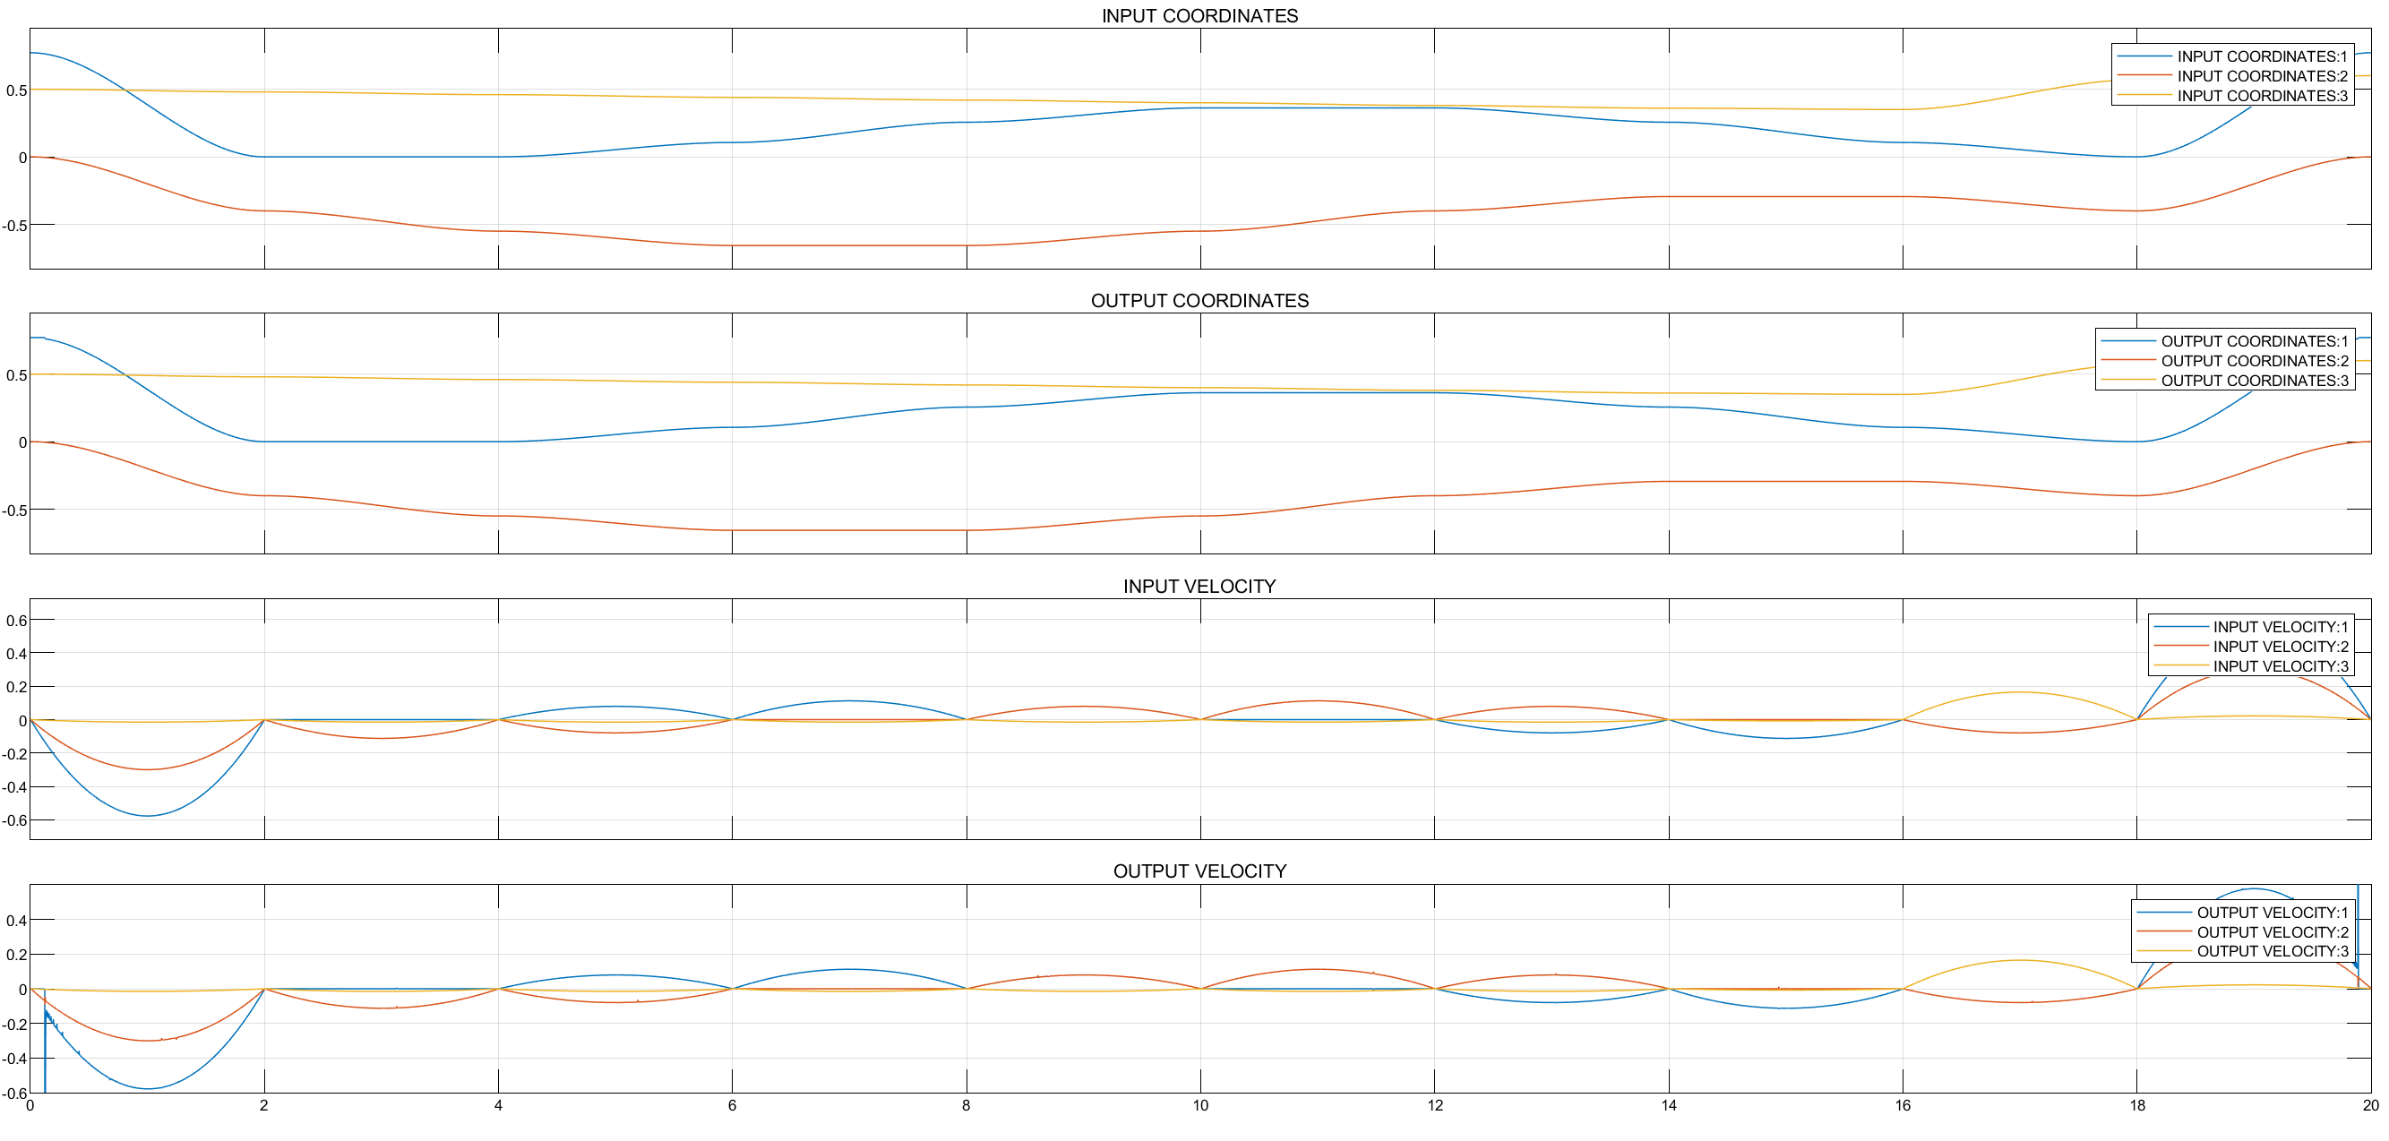

Slide 9
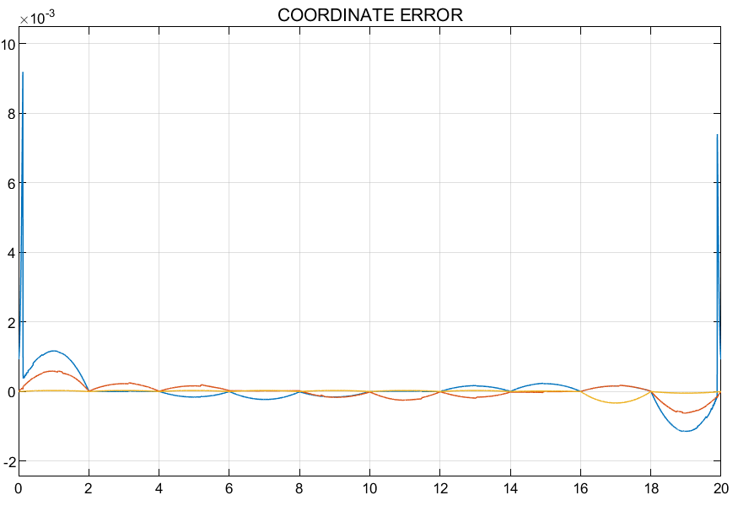

Slide 10
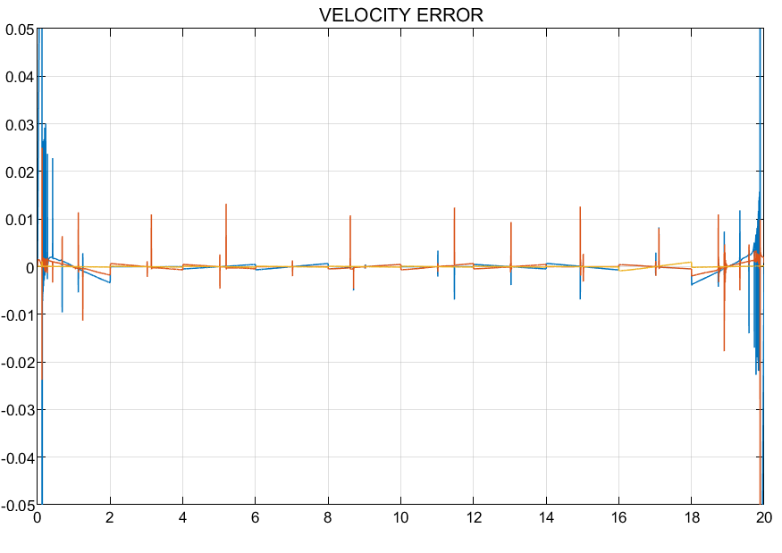

Slide 11
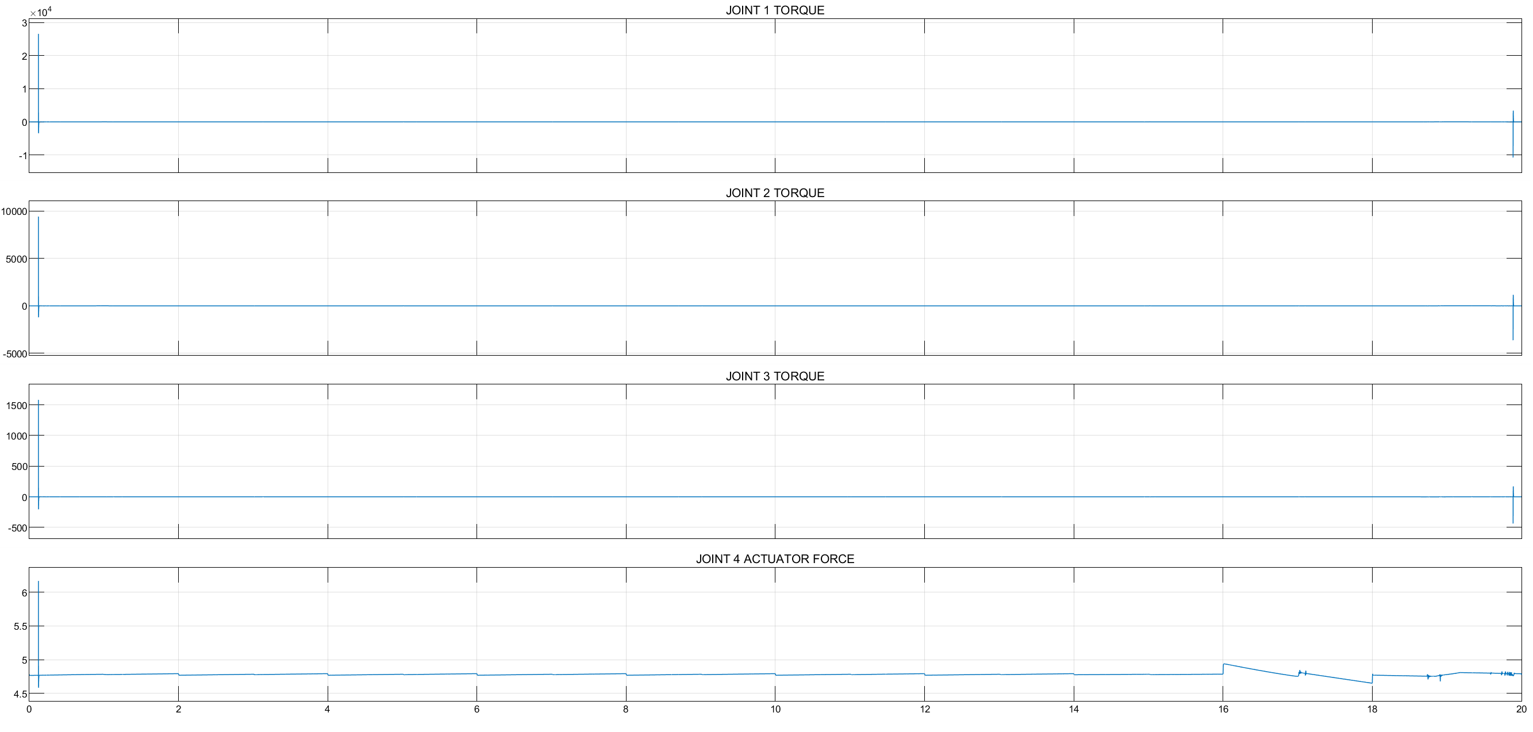

Slide 12
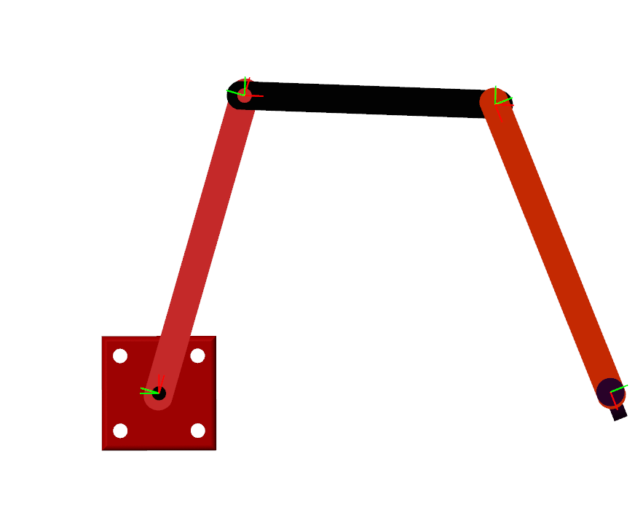








Slide 13
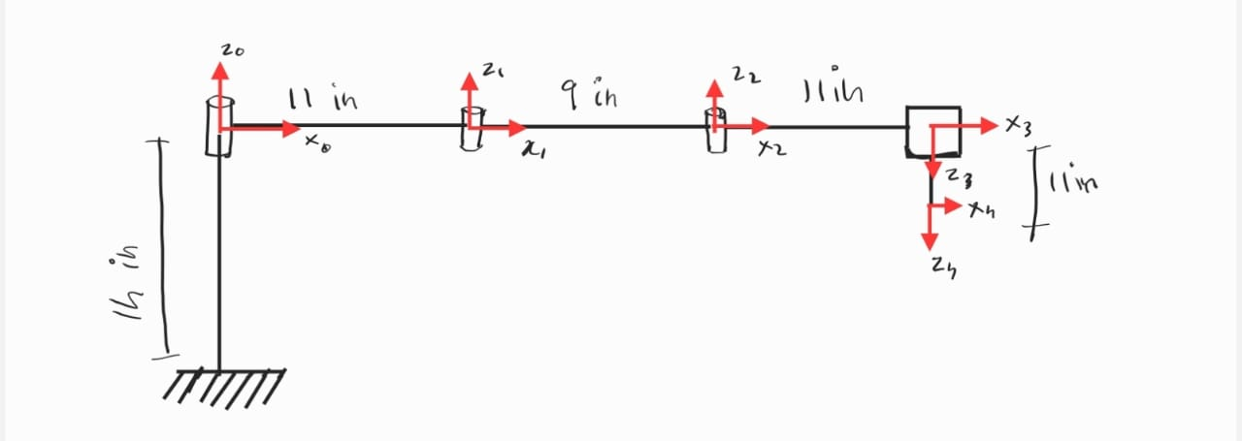
FRAME SETTUP

Slide 14
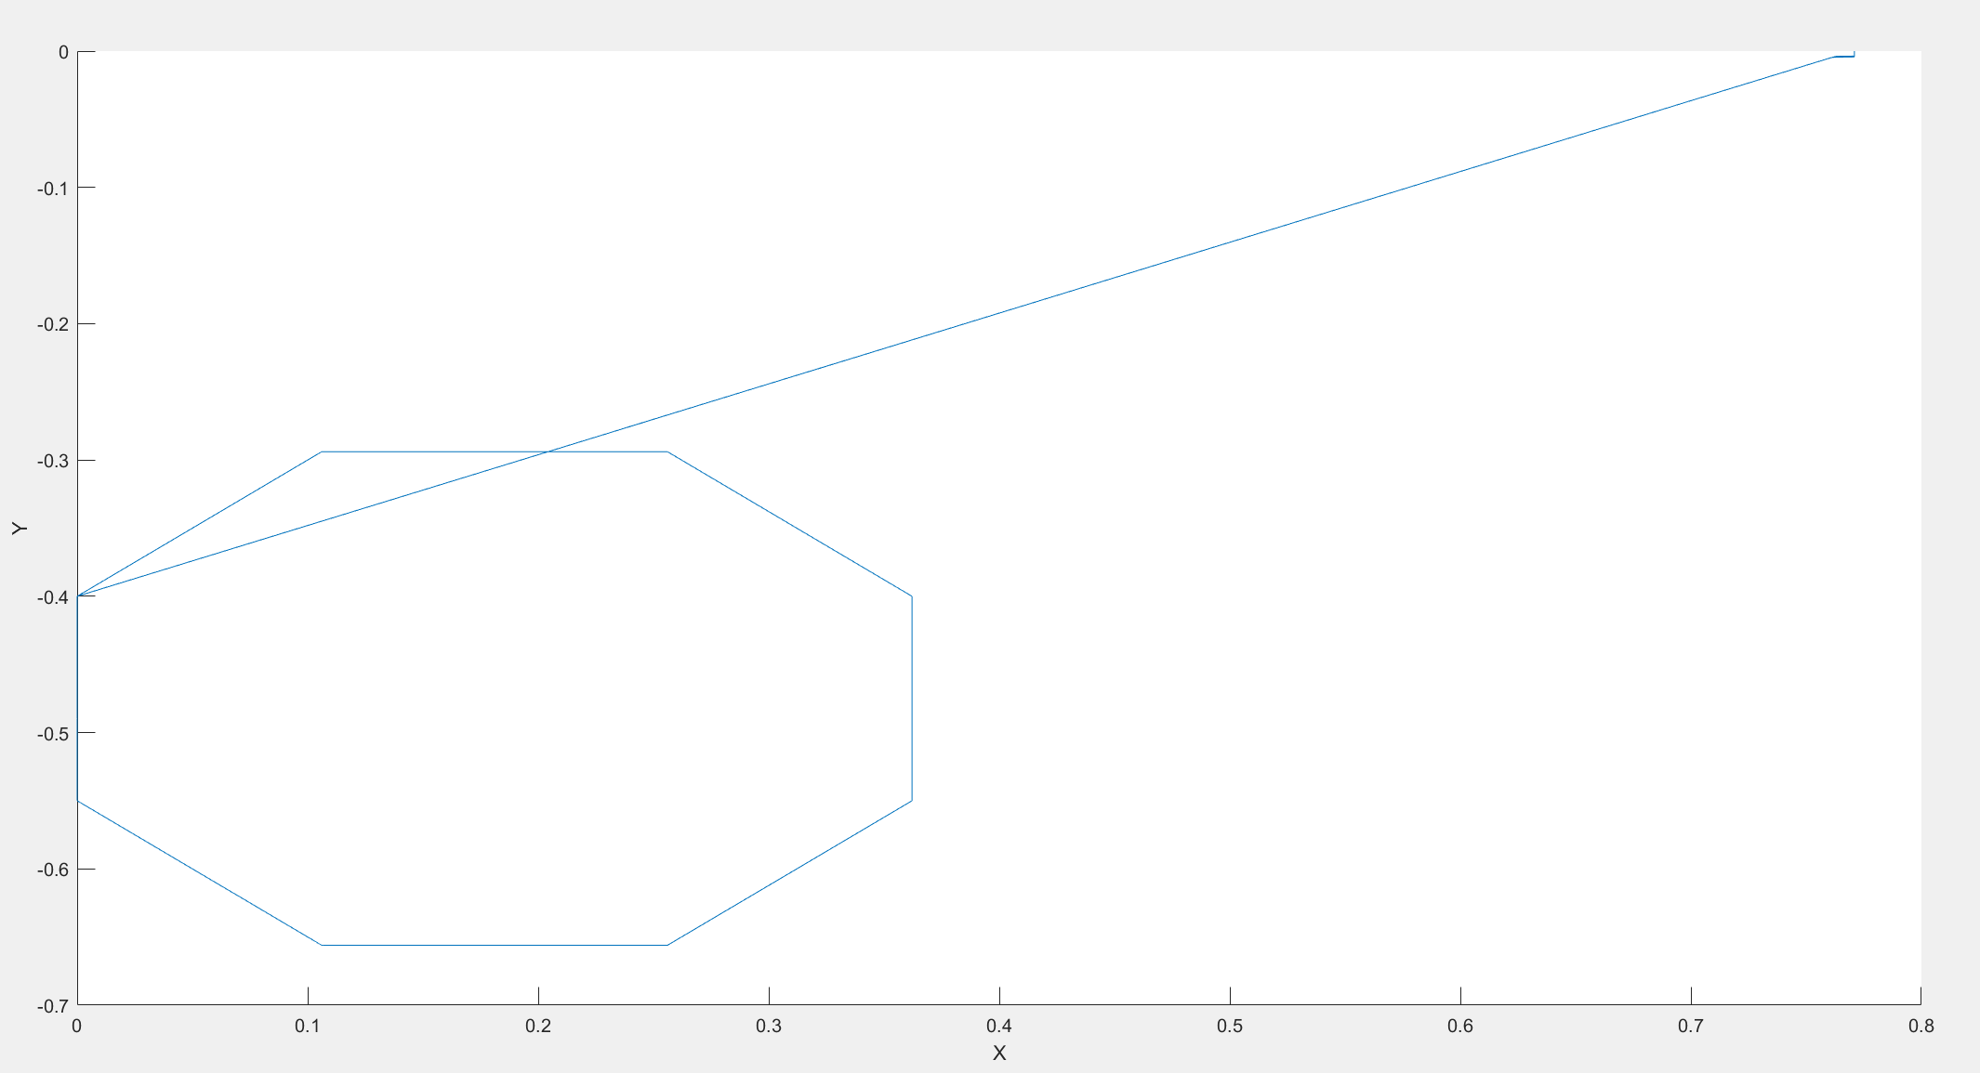

Slide 15
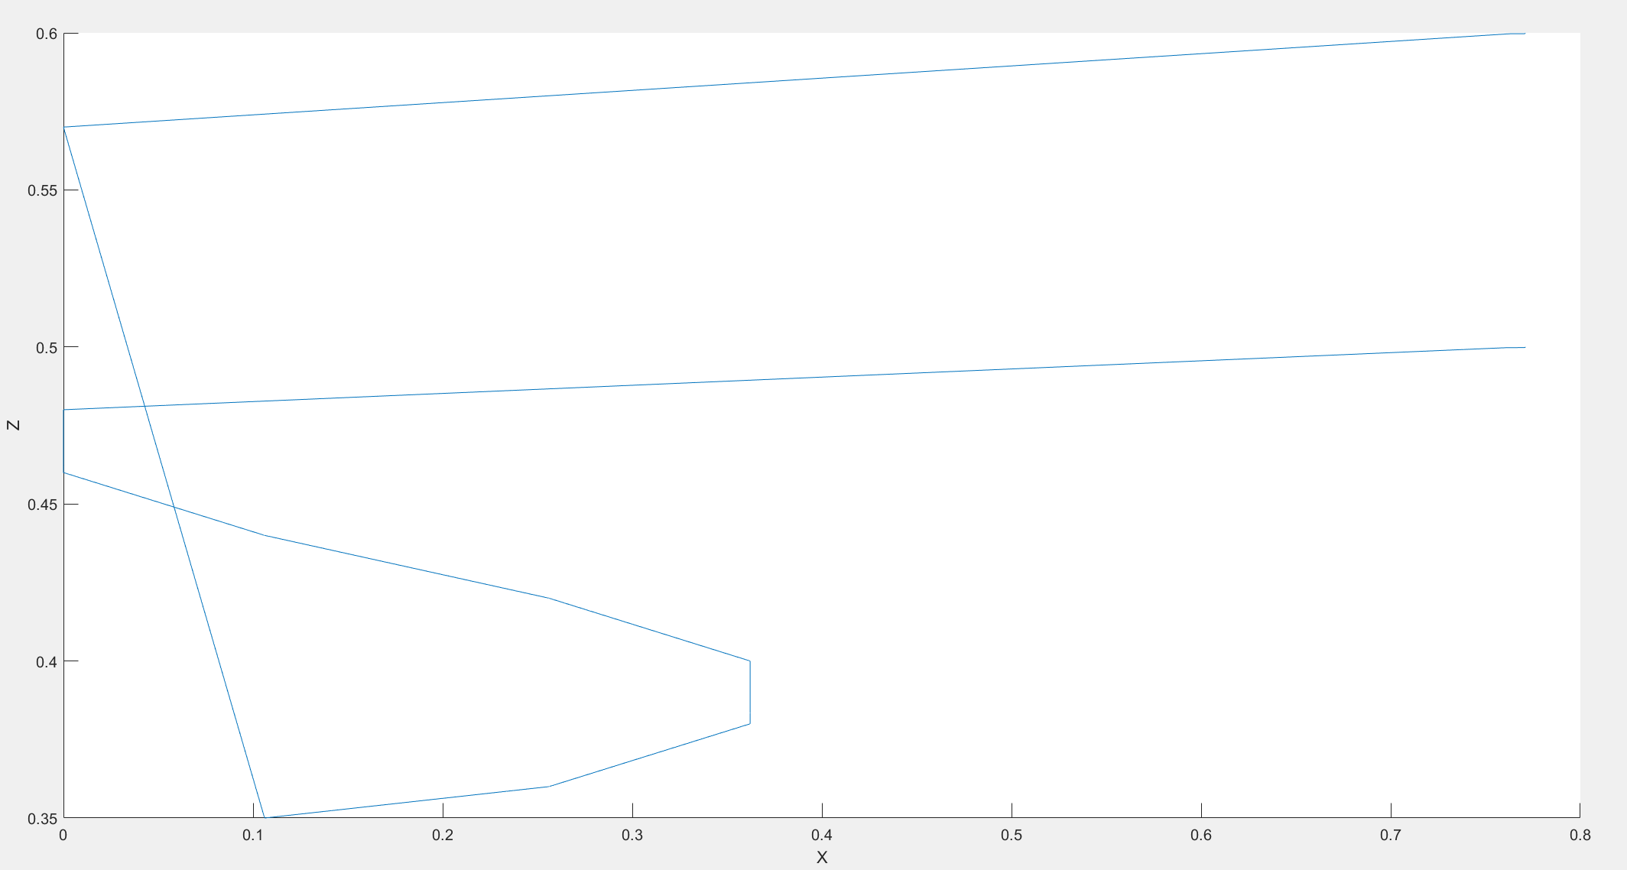

Slide 16
SENSORS FOR 3D SCAN
LIDAR
DEPTH CAMERAS
STRUCTURED LIGHT SYSTEM
ULTRASONIC SENSORS
STEREO VISION SYSTEM

Slide 17
METHODS USED BY THESE SENSORS
LASER SCANNING/RANGING
PHOTOGRAMMETRY
DEPTH PERCEPTION

Slide 18
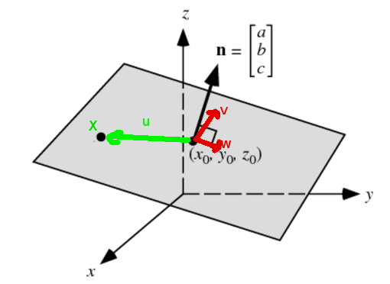
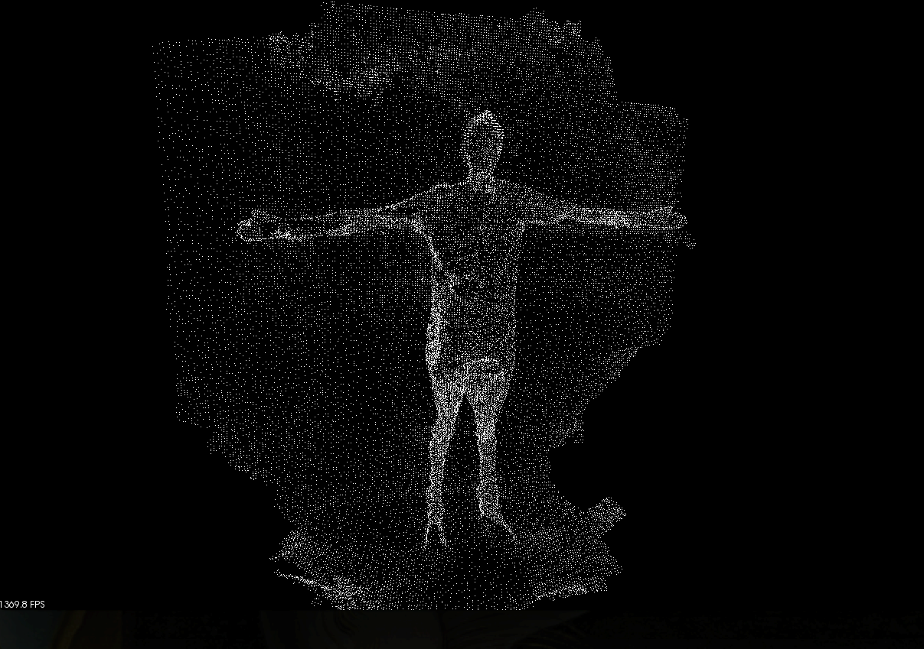

Slide 19
REAL WORLD APPLICATIONS
3D PRINTING
IDUSTRIAL INSPECTION FOR FINDING DEFECTS
AUGMENTED REALITY AND VIRTUAL REALITY

Slide 20
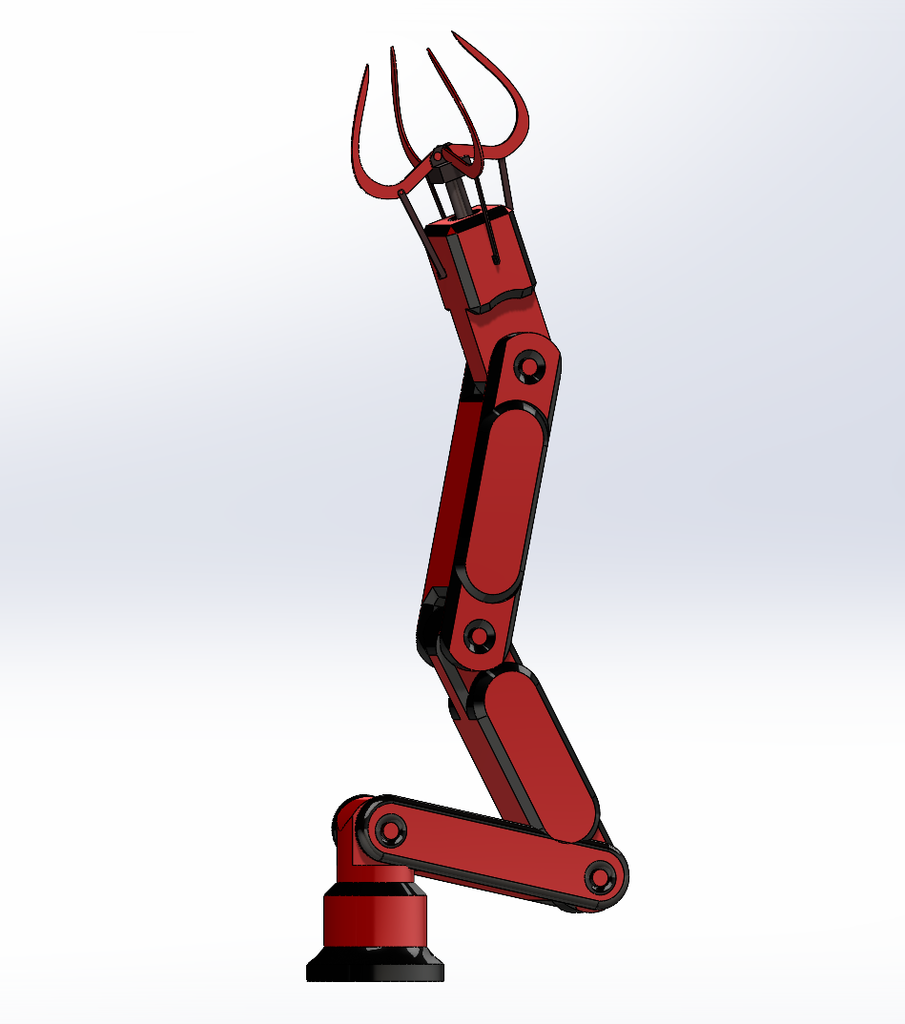
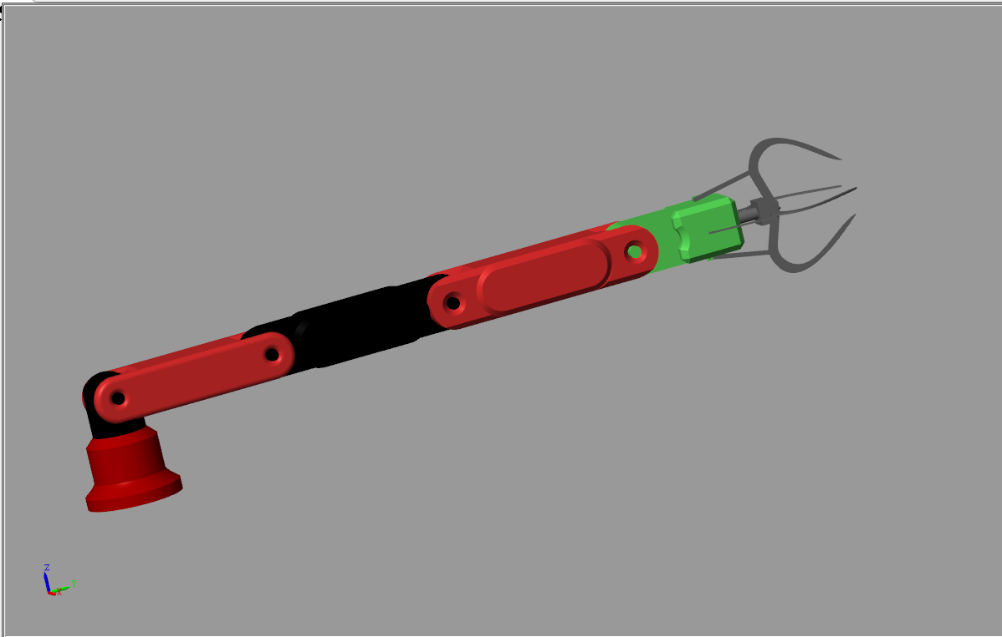

Slide 21
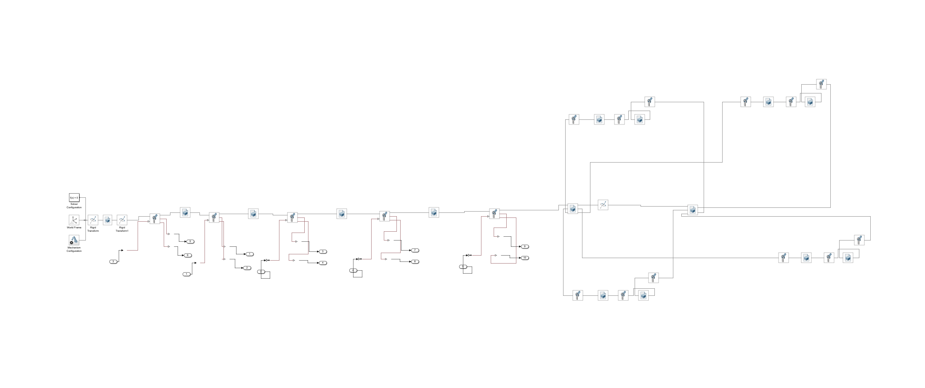

Slide 22
REFERENCE
MET 5800 : KINEMATICS AND DYNAMICS
MEEM 5705 : ROBOTICS AND MECHATRONICS

